Slide 1


Java ee
(ADVANCE JAVA)
Lecture-18

Slide 2

Today’s Agenda
Body section Tags.
Tags .

Slide 3
BODY - SECTION
Body tag is add by a developer to add contents to be shown to his user and all the tags which are child of body tag are divided into two subcategories which are :
Inline Elements .
Block Elements .

Slide 4
TYPES OF BODY TAG
Inline Element – are those which accupy only that much width on the page which is needed to shoe there contents
For ex : <img> , <a> , <b>,<i> etc.
Block Elements – are those which occupy the entire width of the page irrespective of their content .
For ex : <h1>,<ul>,<li>,<div>,<p>etc.

Slide 5
TAGS IN HTML
<p> : paragraph tag is used to display the text it
automatically leaves one line before and after
the text.

Slide 6
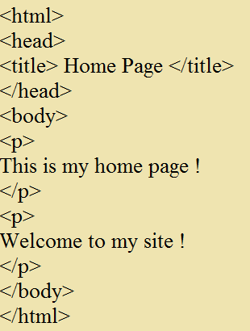
EXAMPLE

Slide 7

OUTPUT

Slide 8
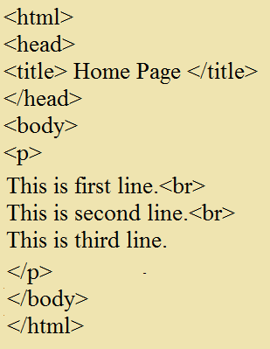
CONTI.
<br> : use to generate new line .

Slide 9

OUTPUT

Slide 10
<hr width=“50%”> : draws a new line and sets the
width of the line and uses two
kind of value in pixel and in
percentage
<hr size=“4”> : it gives the height to the line

Slide 11
DISPLAYING HEADING
<hr align=“left”> : used to align things in specified
direction.
<b> OR <strong> : used to define heading by
making it bold.
<i>OR <em> : make the text italic .

Slide 12
EXAMPLE
<u> : used to underlying the text.
<h1> TO <h6> : defines heading .
<a></a> : anchor tag used to allow the user to
navigate from one page to another
with the help of clickable links.
SYNTAX : <a href =“path/name of
the page” target =“_blank”>text
to display</a>

Slide 13
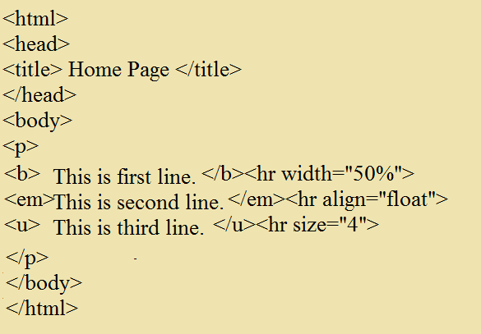
EXAMPLE

Slide 14
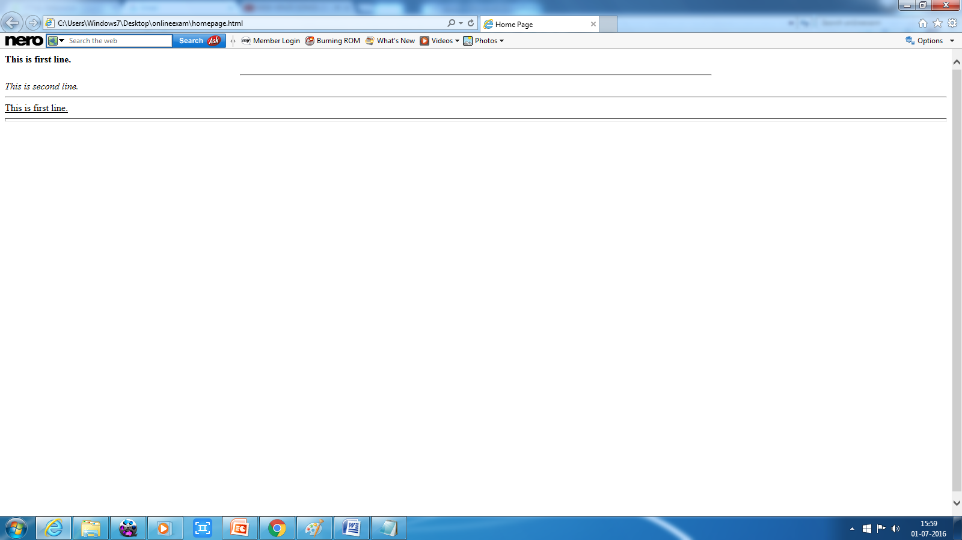
OUTPUT

Slide 15

End Of Lecture
For any queries mail us @: scalive4u@gmail.com
Call us @ : 0755-4271659, 7879165533
Agenda for Next Lecture:
Adding images
Handling Lists

